Slide 1
Control Theory Group Project
Project#2: Radar Control in 3-dimensional space

Slide 2
To design a target tracking system for a radar in 3-dimensional space controlled by changes in azimuth and elevation angles using two respective servo motors.
Challenge:

Slide 3
Background

Slide 4
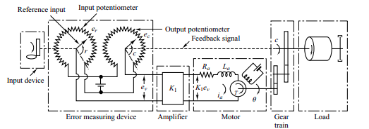


Servo Motors
Generalized Linear Control Equation for servo motors
Schematic Diagram of a Servo Motor
Block Diagram of the System
Transfer Function of the system

Slide 5
Approach and Methodology

Slide 6
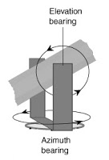
Procedure
The orientation of the motors to determine the structural model of our satellite. (elevation-over-azimuth-mount)
Then we assume the value of mass (an average of what is found in the real world) to find the length parameter from the given moment of inertias of the two servo motors.
Formulation and linearizing the control equations (based on the control equations of servo motors)
Modeling in simulink.

Slide 7
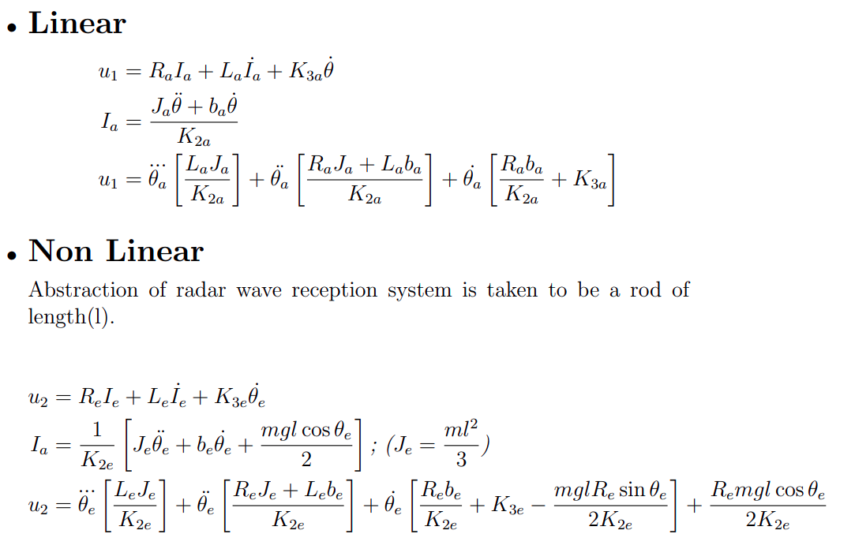

Slide 8
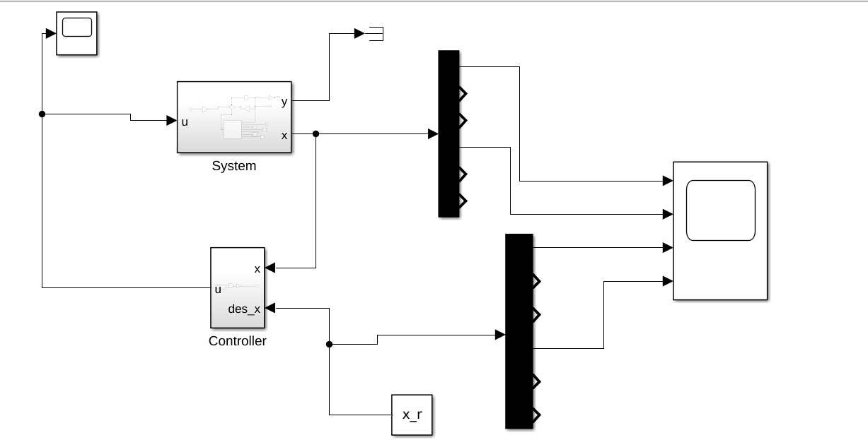
Simulink Model

Slide 9
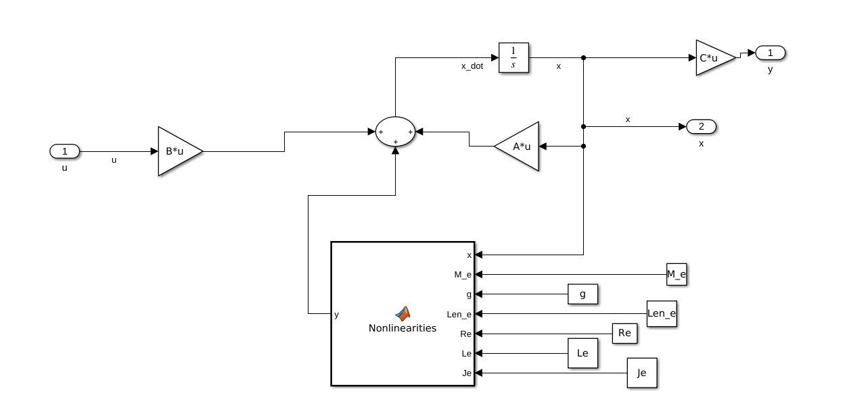
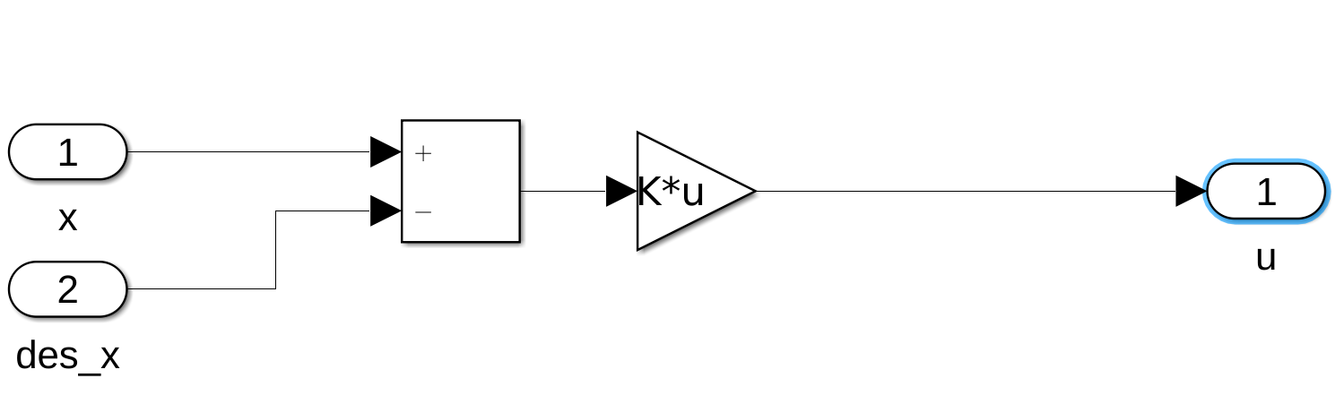
System
Controller

Slide 10
Result

Slide 11
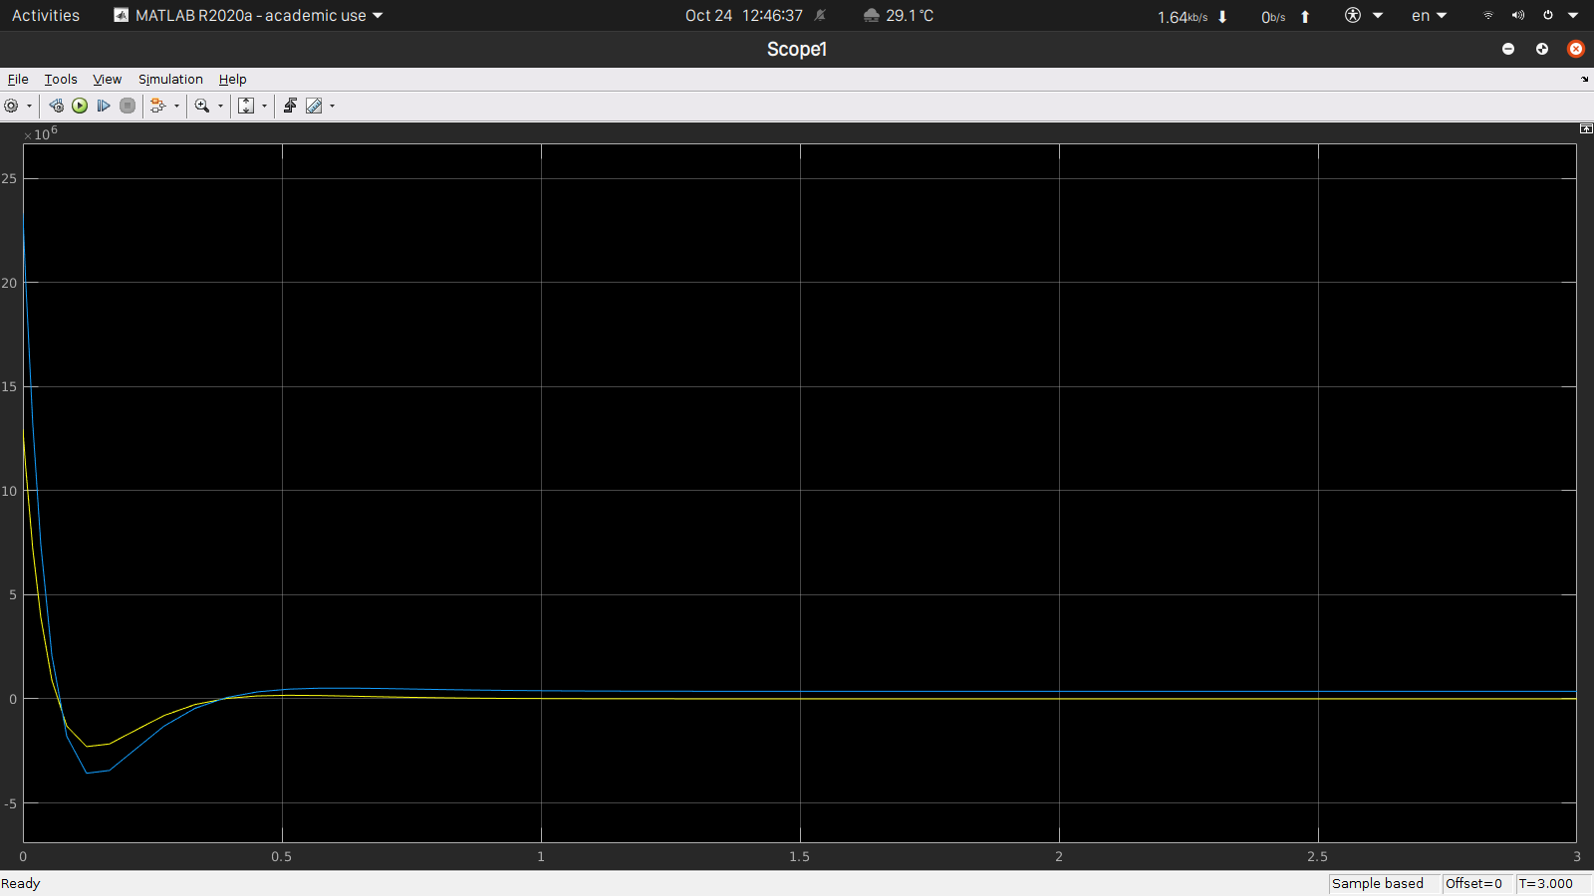
Input

Slide 12
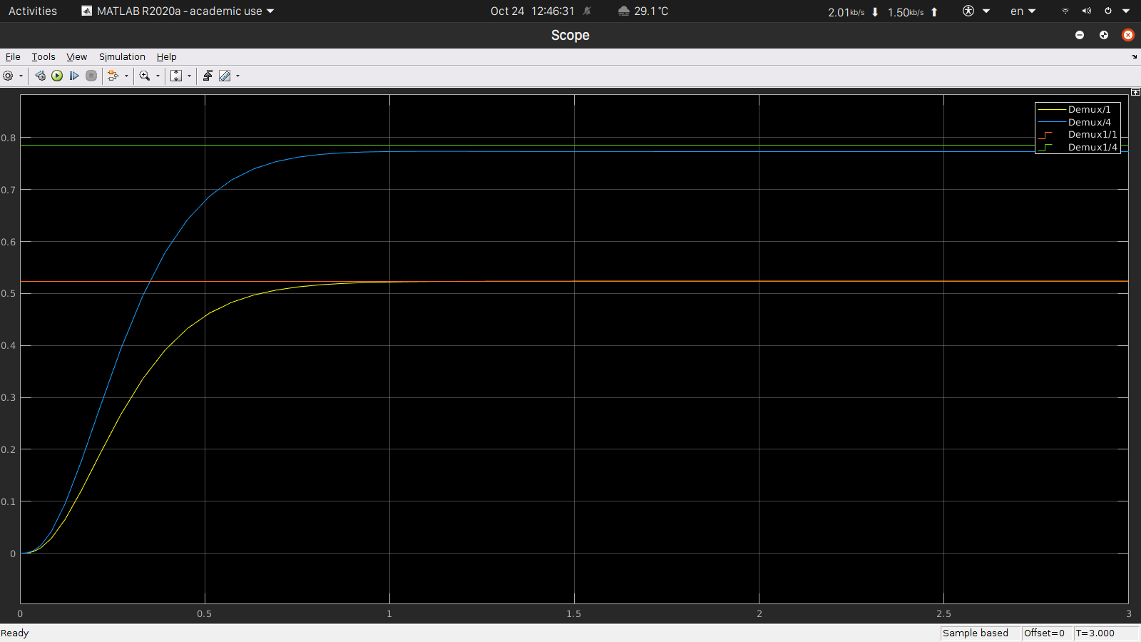
Output

Slide 13
By:
Lavanya Verma [2018155]
Jayant Chhillar [2018151]
Raghav Avasthi [PhD14803]

